Slide 1
Update:9JUNE2023
Topic: Big data and machine learning approaches for drug discovery
Name: Pooja Sanjay Deshmukh
NCL ID: 7030
ACSIR Roll No: 10BB20J26022
Division: Biochemical sciences
Guide: Dr. Durba Sengupta
Doctoral Advisory
Committee:
Dr. Ram Rup Sarkar
Dr. Sailaja Krishnamurty
Dr. Dhanasekaran Shanmugam

Slide 2
Index:
Dataset and Workflow.
Regression and Classification
Dataset and Workflow.
Exploratory Data Analysis
Validation Terminologies
Interpretation of the R² value
ClassificationScores_MACCS, Morgan FPs and RDkit descriptors.
Classification algorithm -Accuracy Score
Classification algorithm -Matthews_corrcoef
RegressionScores_MACCS, Morgan FPs and RDkit descriptors and Linear regression graphs
Regression algorithm and plot_metrics
MSE (Mean Squared Error) and plot_metrics
Predictive models Analysis- Best models
Conclusion and Further Study

Slide 3
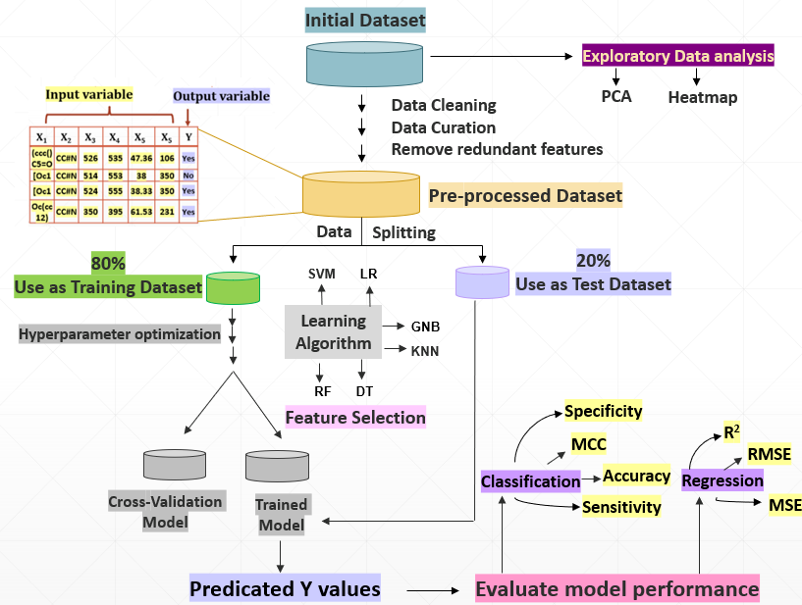
Principal Workflow:
In this study we are predicting optical properties of Fluorescent compound , such as Absorption and Emission maximum wavelengths and their Quantum yield and lifetime using Big data and Machine learning approaches

Slide 4
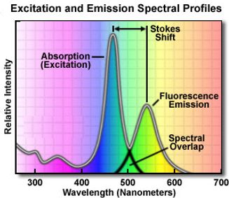
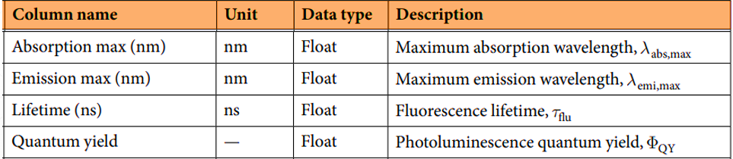
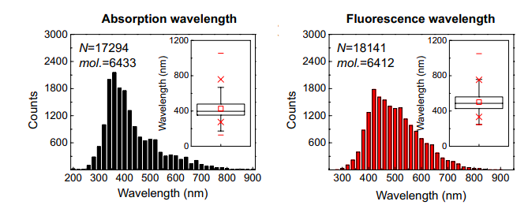
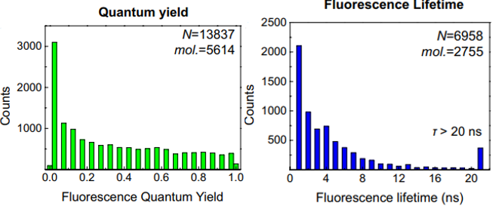
In this study we are predicting optical properties of Fluorescent compound , such as Absorption and Emission maximum wavelengths and their Quantum yield and lifetime using Big data and Machine learning approaches for drug discovery.
λ _{abs,max :}(Lambda max: The wavelength at which a substance has its strongest photon absorption (highest point along the spectrum's y-axis).
λ _{emi,max:} The emission spectrum of a chemical element or chemical compound is the spectrum of frequencies of electromagnetic radiation emitted due to an atom or molecule transitioning from a high energy state to a lower energy state.
Fluorescence lifetime _{τflu:} Fluorescence lifetime (FLT) is the time a fluorophore spends in the excited state before emitting a photon and returning to the ground state. FLT can vary from picoseconds to hundreds of nanoseconds depending on the fluorophore.
Quantum yield _{ΦQY:} The fluorescence quantum yield (ΦF) is the ratio of number of emitted photons (per time and volume unit) relative to the number of absorbed ones (ΦF⩽1)
https://www.abcam.com/index.html?pageconfig=resource&rid=14885
https://www.sciencedirect.com/topics/chemistry/fluorescence-lifetime

Slide 5
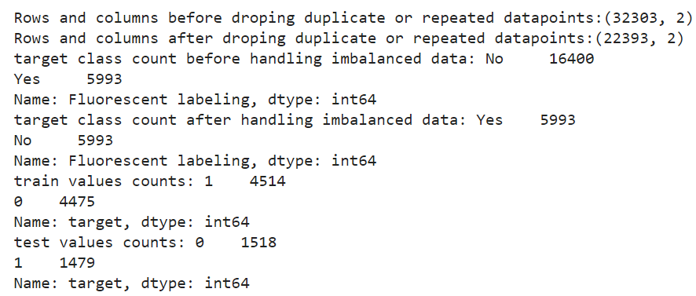
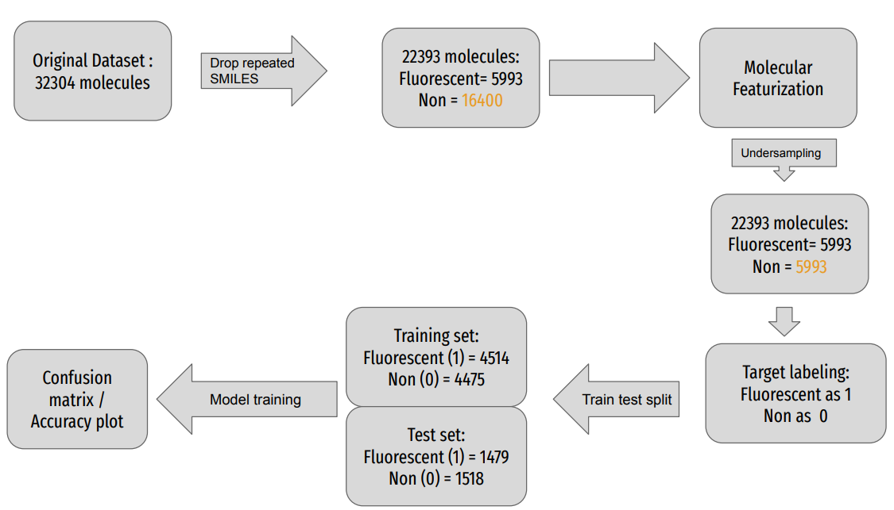
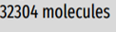
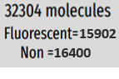
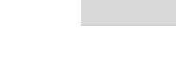
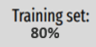
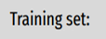
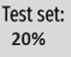
Data and Libraries used
Ongoing Study Workflow
15902
16400
rdkit Chem : majority of chemical functionality (e.g., reading/writing molecules, substructure searching, molecular cleanup, etc.)
rdkit All chem: More advanced, or less frequently used, functionality is considered in All.chem.
DeepChem:Aims to provide a high quality open-source toolchain that democratizes the use of deep-learning in drug discovery, materials science, quantum chemistry, and biology.
Sklerntrain_test_split: The Sklearn train_test_split function helps us create our training data and test data from the same original dataset
Numpy : used to perform a wide variety of mathematical operations on arrays
Pandas: mainly used for data analysis and associated of tabular data in DataFrames
Matplotlib: Matplotlib is a cross-platform, data visualization and graphical plotting library for Python and its numerical extension NumPy.
80%
*Exact number of molecules are not motioned because it will vary as an when we progress the model , some values will dropped/changed in the original dataset.

Slide 6
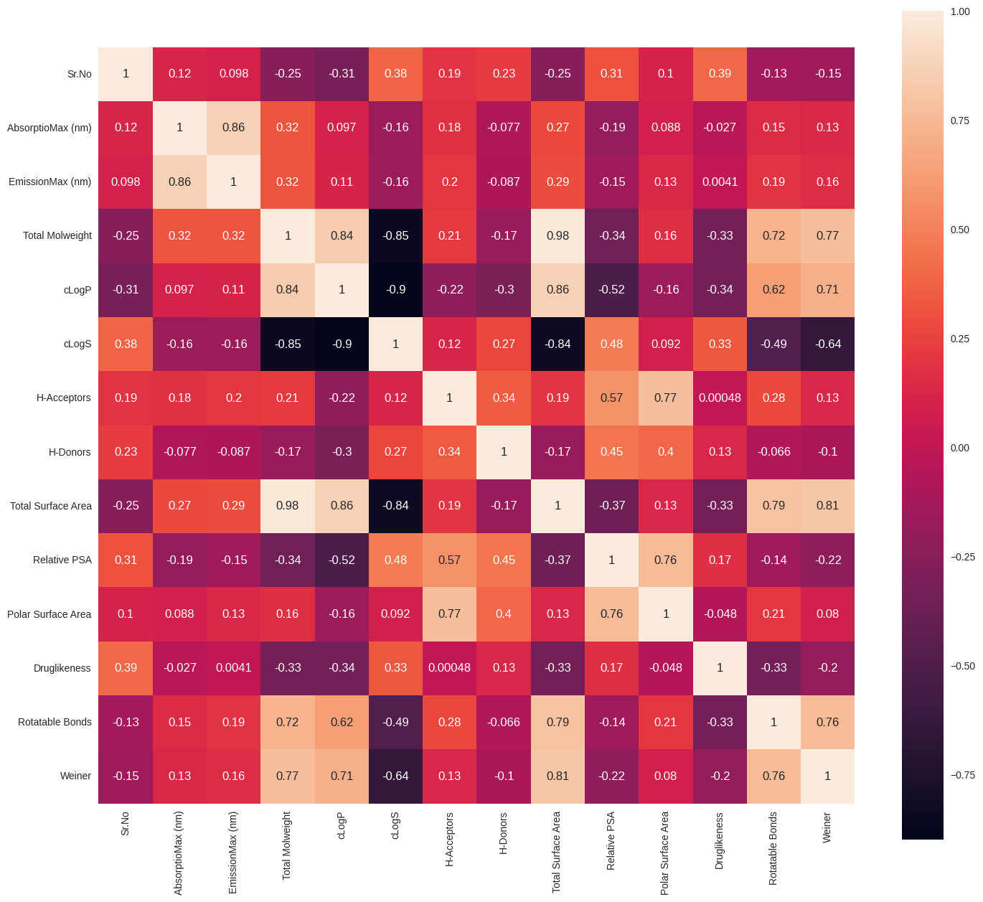
Exploratory Data Analysis
Exploratory data analysis (EDA) is performed in order to gain a preliminary understanding and allow us to get acquainted with the dataset. In a typical ML project, one of the first things is “eyeballing the data” by performing EDA to gain a better understanding of the data. Three major EDA approaches that I normally use includes:
Descriptive statistics — Mean, median, mode, standard deviation.
Data visualizations — Heat maps (discerning feature intra-correlation), box plot (visualize group differences), scatter plots (visualize correlations between features), principal component analysis (visualize distribution of clusters presented in the dataset), etc.
Data shaping — Pivoting data, grouping data, filtering data, etc.

Slide 7
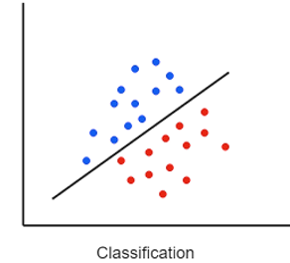
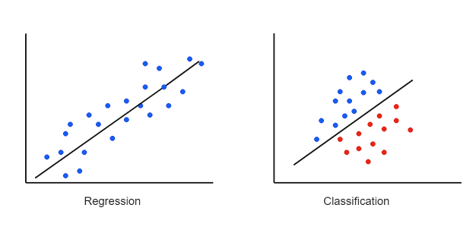
Regression and Classification algorithms are Supervised Learning algorithms. Both the algorithms are used for prediction in Machine learning and work with the labeled datasets.
a
Classification Algorithms (Fluorescent -Yes/NO) | Regression Algorithms (λmax- Real values)
A tree model where the target variable can take a discrete set of values | A tree model where the target variable can take continuous values typically real numbers
The dependent variables are categorical . | The dependent variables are numerical .
Classification is a process of finding a function which helps in dividing the dataset into classes based on different parameters. In Classification, a computer program is trained on the training dataset and based on that training, it categorizes the data into different classes. | Regression is a statistical method that determine the strength and character of the relationship between one dependent variable (usually denoted by Y) and a series of other variables (known as independent variables). Regression is a process of finding the correlations between dependent and independent variables. It helps in predicting the continuous variables such as prediction of Market Trends, prediction of House prices, finance etc.
In Classification, the output variable must be a discrete value. Classification algorithms are used to predict/Classify the discrete values such as Male or Female, True or False, Spam or Not Spam, etc. | In Regression, the output variable must be of continuous nature or real value (continuous values such as price, salary, age, etc.)
The task of the classification algorithm is to map the input value(x) with the discrete output variable(y). In Classification, we try to find the decision boundary, which can divide the dataset into different classes. | The task of the regression algorithm is to map the input value (x) with the continuous output variable(y). In Regression, we try to find the best fit line, which can predict the output more accurately. Regression algorithms can be used to solve the regression problems such as Weather Prediction, House price prediction, etc.
The Classification algorithms can be divided into Binary Classifier and Multi-class Classifier. Following Classification Algorithm used in current study: Random Forest Support Vector Machine Linear Discriminant Analysis (LDA) Gaussian Naive Bayes Logistic Regression Decision Tree K-Nearest Neighbors | The regression Algorithm can be further divided into Linear and Non-linear Regression. Following Regression Algorithm used in current study: Random Forest Regression Support Vector Regression ElasticNet Regression Ridge Regression Lasso Regression Decision Tree Regression K-Nearest Neighbors Regression

Slide 8
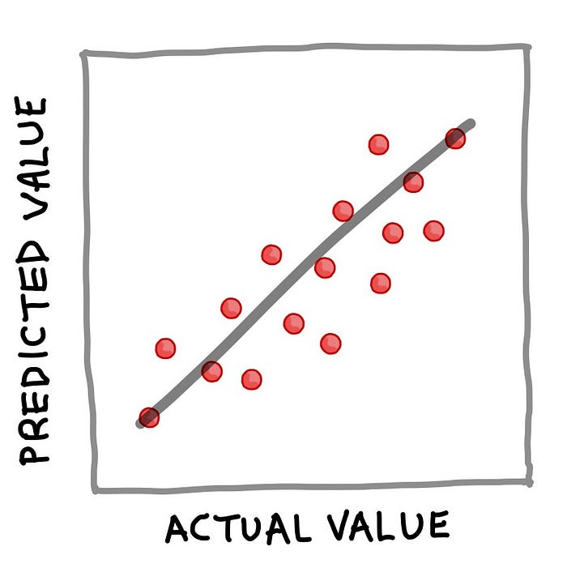
Regression
In a nutshell, a trained regression model can be best summarized by the following simple equation: Y=f(X)
where Y corresponds to the quantitative output variable, X refers to the input variables and f refers to the mapping function (obtained from the trained model) for computing the output values as a function of input features. The essence of the above equation for the regression example is that Y can be deduced if X is known. Once Y is calculated (we can also say ‘predicted’), a popular way to visualize the results is to make a simple scatter plot of the actual values versus the predicted values as shown below.
Dataset, separating the data to X and Y matrices, perform 80/20 data split, build a linear regression model using the 80% subset and applying the trained model to make prediction on the 20% subset. Finally, the performance metrics and scatter plot of the actual versus predicted MEDV ( median value).
Performance metrics
Evaluation of the performance of regression models are performed to assess the degree at which a fitted model can accurately predict the values of input data. Common metric for evaluating the performance of regression models is the coefficient of determination (R²).
As can be seen from the equation, R² is essentially 1 minus the ratio of the residual sum of squares to that of the total sum of squares. In simple terms, it can be said to represent the relative measure of explained variance. For example, if R² = 0.6 then it means that the model could explain 60% of the variance (i.e. that is 60% of the data fits the regression model) whereas the unexplained variance accounted for the remaining 40%.
Additionally, the mean squared error (MSE) as well as the root mean squared error (RMSE) are also common measures of the residuals or error of prediction.
As can be seen from the above equation, the MSE is as the name implies easily computed by taking the mean of the squared error. Furthermore, a simple square root of the MSE yields the RMSE.

Slide 9
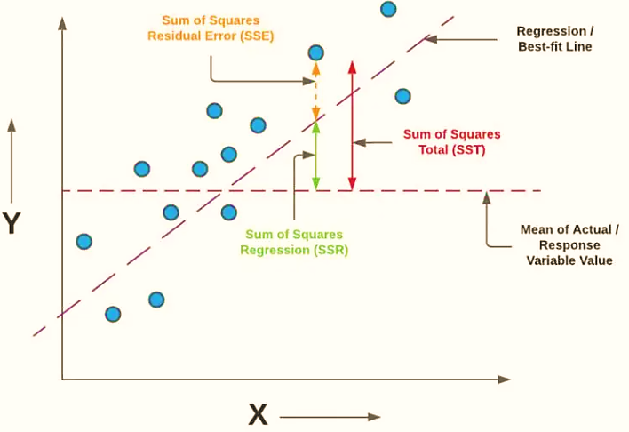
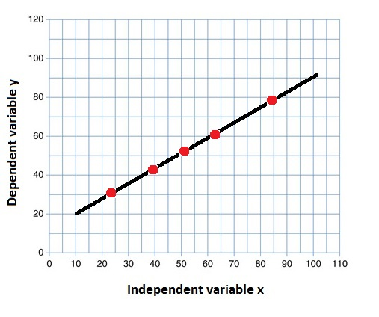
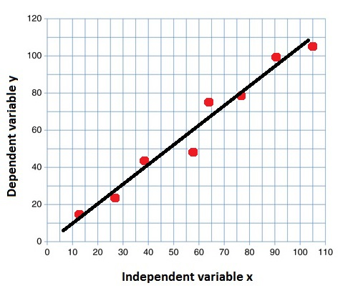
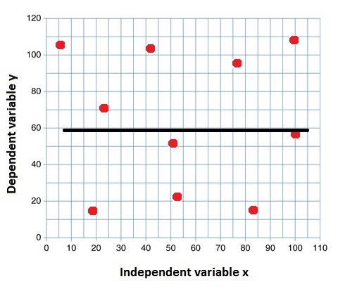
Validation: R² is a measure of the goodness of fit of a model. In regression, the R² coefficient of determination is a statistical measure of how well the regression predictions approximate the real data points. An R² of 1 indicates that the regression predictions perfectly fit the data.
The coefficient of determination, or R², is a measure that provides information about the goodness of fit of a model. In the context of regression, it is a statistical measure of how well the regression line approximates the actual data. It is therefore important when a statistical model is used either to predict future outcomes or in the testing of hypotheses. There are several variants.
An ‘Independent variable’ is the variable deploy or vary in an experimental study to explore its effects. It’s called “independent” because it’s not influenced by any other variables in the study.
A ‘Dependent variable’ is the variable that changes as a result of the independent variable manipulation. It’s the outcome you’re interested in measuring, and it “depends” on your independent variable.
Interpretation of the R² value
R²=1
All the variation in the y values is accounted for by the x values.
R²=0.83
83% of the variation in the y values is accounted for by the x values
R² = 0
None of the variation in the y values is accounted for by the x values
https://www.ncl.ac.uk/webtemplate/ask-assets/external/maths-resources/statistics/regression-and-correlation/coefficient-of-determination-r-squared.html

Slide 10
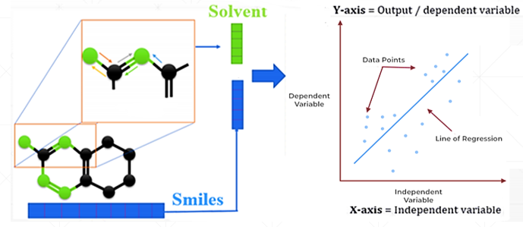
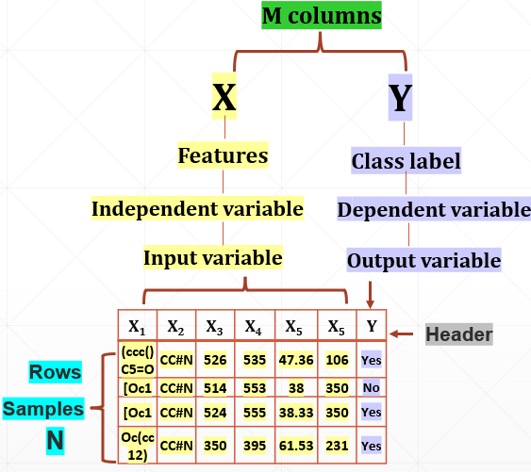

Dataset X and Y distribution:
+
Quantum yield & Lifetime(ns)
AbsorptioMax (nm): λ _{abs, max}
EmissionMax (nm): λ _{emi, max}
Target Properties
Dependent & Independent
y = f(x)
dependent = f(independent)
AbsorptionMax = f(smiles)
Dependent & Independent
y = f(x)
dependent = f(independent)
EmissionMax = f(smiles)
‘X’: Smiles (Structure +Solvent concatenated)
‘Y’: λ _{abs, max and} λ _{emi, max}
A dataset is the starting point in your journey of building the machine learning model. Simply put, the dataset is essentially an M×N matrix where M represents the columns (features) and N the rows (samples).
Columns can be broken down to X and Y. Firstly, X is synonymous with several similar terms such as features, independent variables and input variables. Secondly, Y is also synonymous with several terms namely class label, dependent variable and output variable.
It should be noted that a dataset that can be used for supervised learning (can perform either regression or classification) would contain both X and Y whereas a dataset that can be used for unsupervised learning will only have X.
Moreover, if Y contains quantitative values, then the dataset (comprising of X and Y) can be used for regression tasks whereas if Y contains qualitative values, then the dataset (comprising of X and Y) can be used for classification tasks.

Slide 11
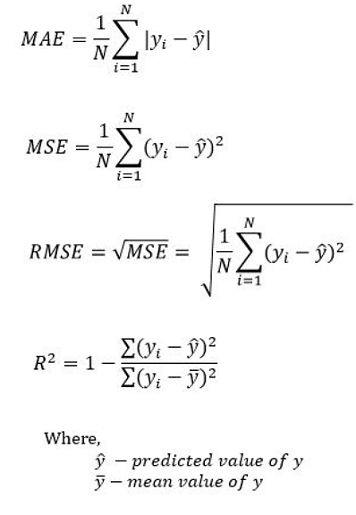
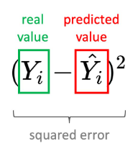
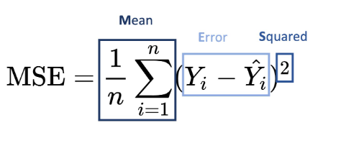
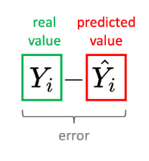
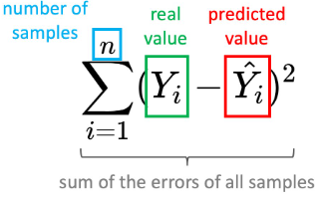
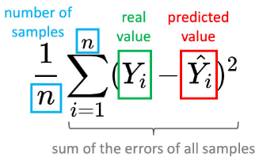
Validation Terminologies
Evaluating the model accuracy is an essential part of the process in creating machine learning models to describe how well the model is performing in its predictions. Evaluation metrics change according to the problem type. The linear model (regression) can be a typical example of this type of problem, and the main characteristic of the regression problem is that the targets of a dataset contain the real numbers only. The errors represent how much the model is making mistakes in its prediction. The basic concept of accuracy evaluation is to compare the original target with the predicted one according to certain metrics.
Regression model evaluation metrics: The MSE, MAE, RMSE, and R-Squared metrics are mainly used to evaluate the prediction error rates and model performance in regression:
MAE (Mean absolute error) represents the difference between the original and predicted values extracted by averaged the absolute difference over the data set.
MSE (Mean Squared Error) represents the difference between the original and predicted values extracted by squared the average difference over the data set.
RMSE (Root Mean Squared Error) is the error rate by the square root of MSE.
R-squared (Coefficient of determination) represents the coefficient of how well the values fit compared to the original values. The value from 0 to 1 interpreted as percentages. The higher the value is, the better the model is.
https://www.datatechnotes.com/2019/02/regression-model-accuracy-mae-mse-rmse.html
https://suboptimal.wiki/explanation/mse/

Slide 12
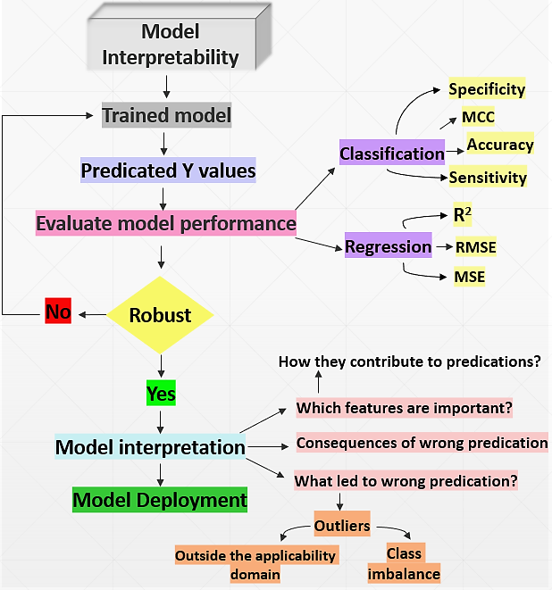
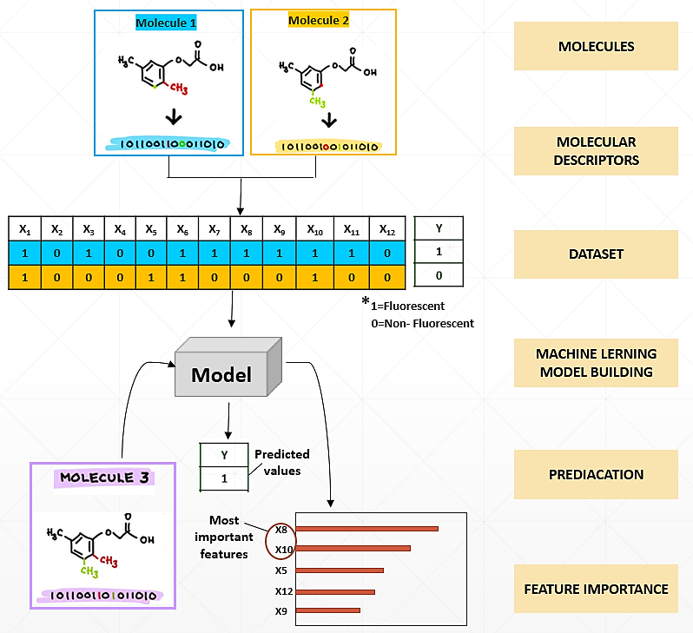
Model interpretability
Model performance is estimated in terms of its accuracy to predict the occurrence of an event on a data. A more accurate model is seen as a more valuable model. Model interpretability provides insight into the relationship between in the inputs and the output.

Slide 13
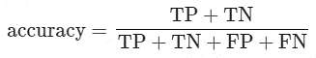
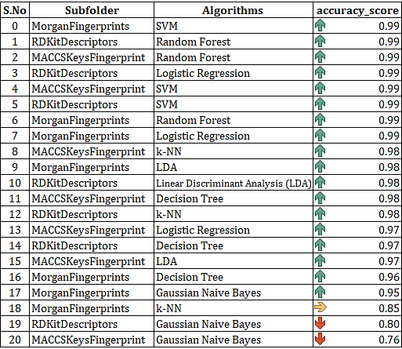
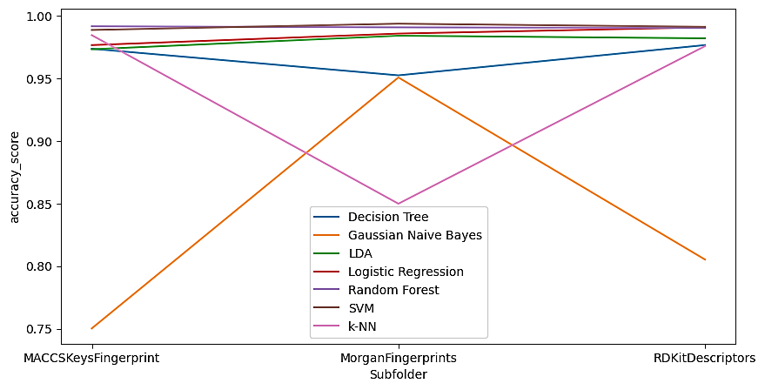
Classification algorithm -Accuracy Score
Comparison plots: λmax(R² Score) , Molecular fingerprints–descriptors with Machine learning
Accuracy, represents the ratio between the correctly predicted instances and all the instances in the dataset.
Random forest > Support Vector Machine >Logistics Regression >Linear Discriminant Analysis -LDA >Decision tress K- Nearest Neighbour KNN > Gaussian Naïve Bayes

Slide 14
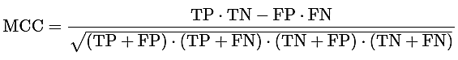
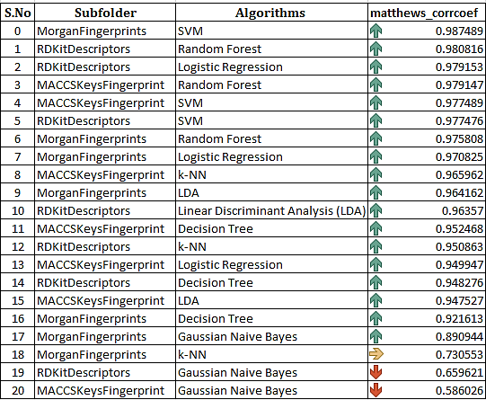
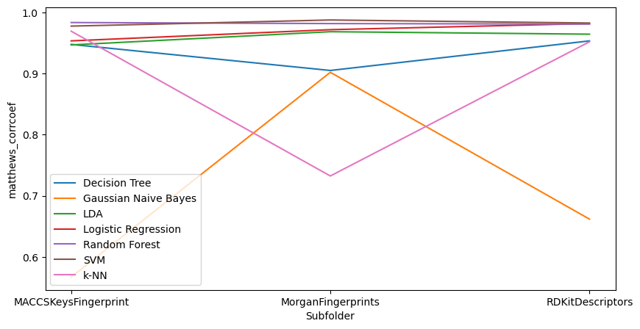
Classification algorithm -Matthews_corrcoef
Comparison plots: λmax(R² Score) , Molecular fingerprints–descriptors with Machine learning
MCC As an alternative measure unaffected by the unbalanced datasets issue, the Matthews correlation coefficient is a contingency matrix method of calculating the Pearson product-moment correlation coefficient between actual and predicted values. The Matthews correlation coefficient (MCC), is a more reliable statistical rate which produces a high score only if the prediction obtained good results in all of the four confusion matrix categories (true positives, false negatives, true negatives, and false positives).
Random forest > Support Vector Machine >Logistics Regression >Linear Discriminant Analysis –LDA >
Decision tress >K- Nearest Neighbour KNN > Gaussian Naïve Bayes

Slide 15
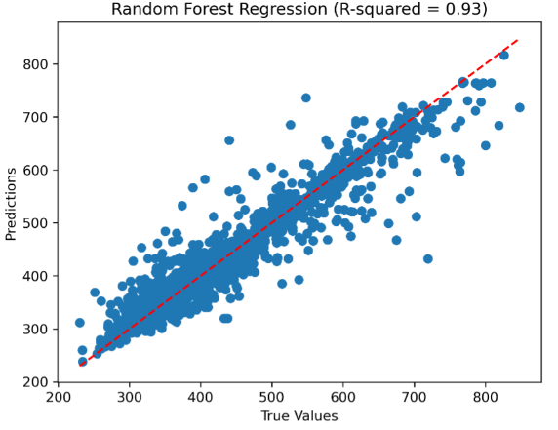
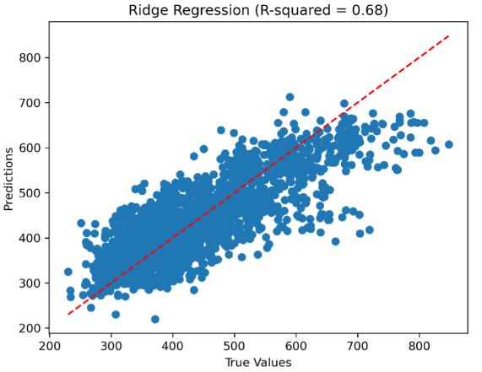
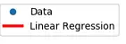
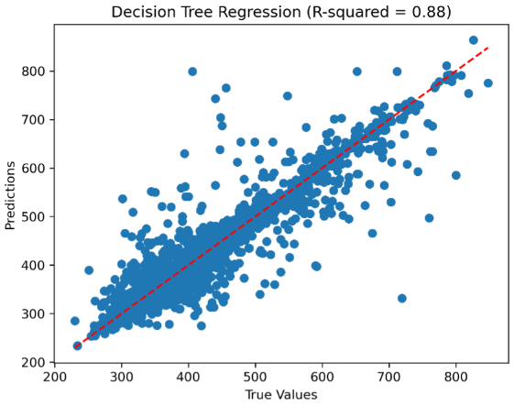
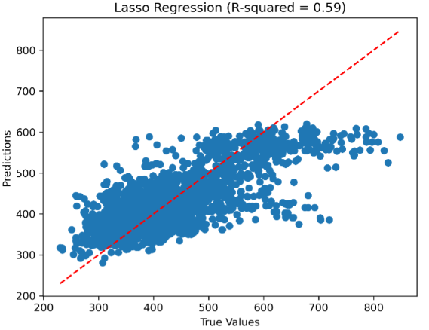
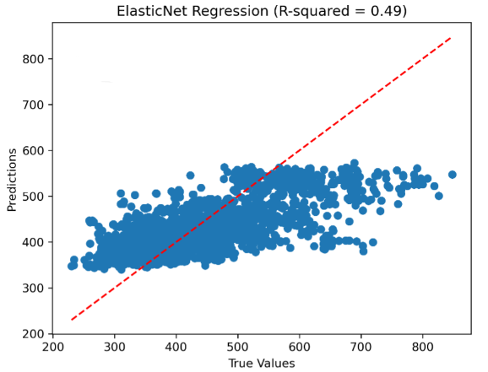
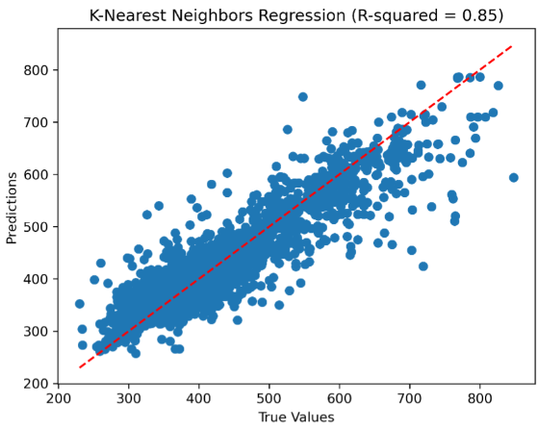
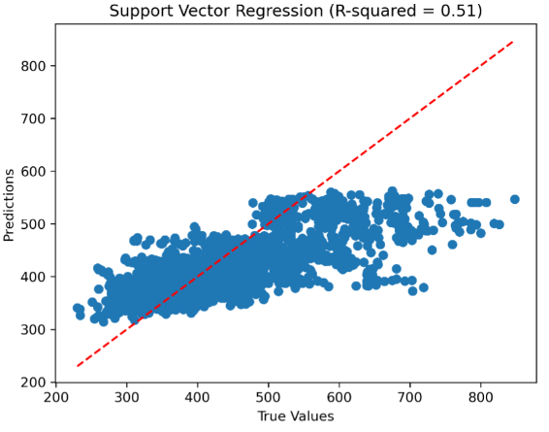
RegressionScores_ MACCS:AbsorptioMax(nm)
FPs | Algorithm | r2_score | Regression Scores
MACCS | Random Forest Regression | 0.93 | mean_absolute_erro | 14.88
 |  |  | mean_squared_error | 726.32
 |  |  | r2_score | 0.93
 | Support Vector Regression | 0.51 | mean_absolute_erro | 47.63
 |  |  | mean_squared_error | 4794.95
 |  |  | r2_score | 0.51
 | ElasticNet Regression | 0.49 | mean_absolute_erro | 52.35
 |  |  | mean_squared_error | 4989.48
 |  |  | r2_score | 0.49
 | Lasso Regression | 0.59 | mean_absolute_erro | 47.16
 |  |  | mean_squared_error | 4023.04
 |  |  | r2_score | 0.59
 | Ridge Regression | 0.68 | mean_absolute_erro | 41.33
 |  |  | mean_squared_error | 3110.49
 |  |  | r2_score | 0.68
 | Decision Tree Regression | 0.88 | mean_absolute_erro | 17.09
 |  |  | mean_squared_error | 1207.82
 |  |  | r2_score | 0.88
 | K-Nearest Neighbors Regression | 0.85 | mean_absolute_erro | 24.02
 |  |  | mean_squared_error | 1425.10
 |  |  | r2_score | 0.85

Slide 16
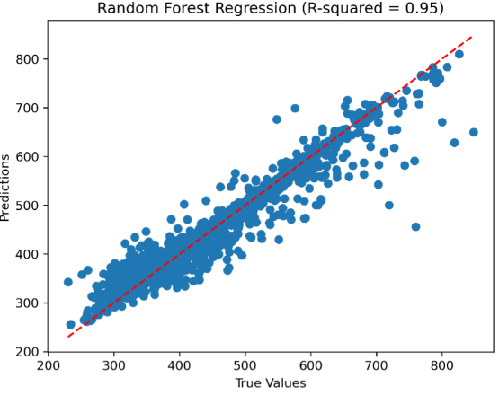
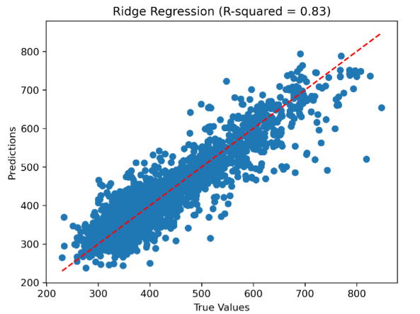
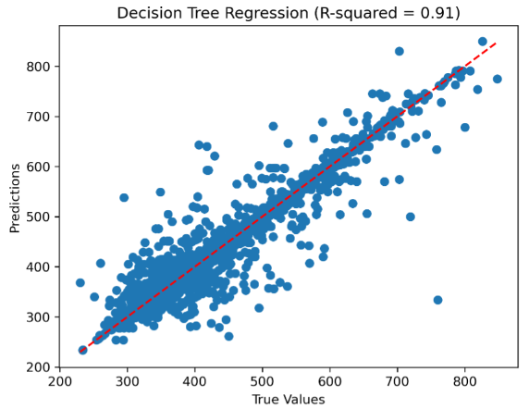
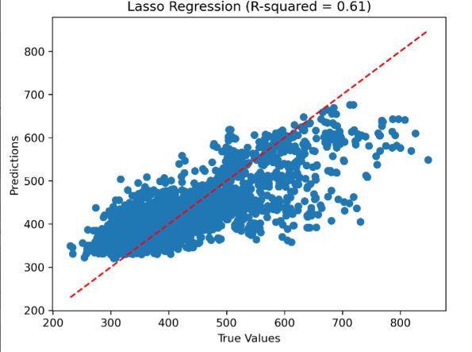
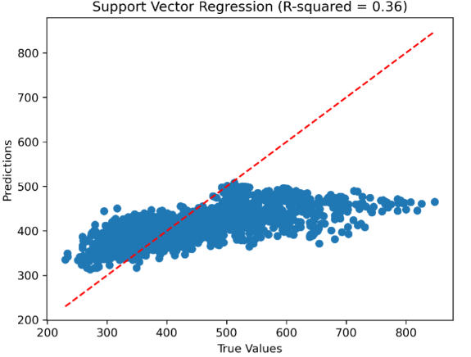


RegressionScores_ Morgan:AbsorptioMax(nm)
FPs | Algorithm | r2_score | Regression Scores
Morgan | Random Forest Regression | 0.95 | mean_absolute_erro | 13.05
 |  |  | mean_squared_error | 831.36
 |  |  | r2_score | 0.91
 | Support Vector Regression | 0.36 | mean_absolute_erro | 52.69
 |  |  | mean_squared_error | 6156.45
 |  |  | r2_score | 0.36
 | ElasticNet Regression | 0.46 | mean_absolute_erro | 53.32
 |  |  | mean_squared_error | 5217.40
 |  |  | r2_score | 0.46
 | Lasso Regression | 0.61 | mean_absolute_erro | 44.41
 |  |  | mean_squared_error | 3734.33
 |  |  | r2_score | 0.61
 | Ridge Regression | 0.83 | mean_absolute_erro | 28.80
 |  |  | mean_squared_error | 1618.49
 |  |  | r2_score | 0.83
 | Decision Tree Regression | 0.91 | mean_absolute_erro | 13.05
 |  |  | mean_squared_error | 831.36
 |  |  | r2_score | 0.91
 | K-Nearest Neighbors Regression | 0.91 | mean_absolute_erro | 14.18
 |  |  | mean_squared_error | 867.05
 |  |  | r2_score | 0.91

Slide 17







RegressionScores_Rdkit Descriptor
AbsorptioMax(nm)
Subfolder | Algorithm | r2_score | Regression Scores
Rdkit Descriptor | Random Forest Regression | 0.95 | mean_absolute_erro | 11.36
 |  |  | mean_squared_error | 521.83
 |  |  | r2_score | 0.95
 | Support Vector Regression | 0.44 | mean_absolute_erro | 51.38
 |  |  | mean_squared_error | 5461.30
 |  |  | r2_score | 0.44
 | ElasticNet Regression | 0.62 | mean_absolute_erro | 44.49
 |  |  | mean_squared_error | 3711.48
 |  |  | r2_score | 0.62
 | Lasso Regression | 0.65 | mean_absolute_erro | 42.00
 |  |  | mean_squared_error | 3369.13
 |  |  | r2_score | 0.65
 | Ridge Regression | 0.73 | mean_absolute_erro | 36.30
 |  |  | mean_squared_error | 2571.53
 |  |  | r2_score | 0.73
 | Decision Tree Regression | 0.88 | mean_absolute_erro | 14.24
 |  |  | mean_squared_error | 1116.32
 |  |  | r2_score | 0.88
 | K-Nearest Neighbors Regression | 0.80 | mean_absolute_erro | 29.07
 |  |  | mean_squared_error | 1947.41
 |  |  | r2_score | 0.80

Slide 18



Regression algorithm:AbsorptioMax(nm)
Comparison plots: λmax(R² Score) , Molecular fingerprints–descriptors with Machine learning Regression algorithm
R-squared (Coefficient of determination) represents the coefficient of how well the values fit compared to the original values. The value from 0 to 1 interpreted as percentages.
The higher the value is, the better the model is (R² Score Ranges between 0 and 1 0.90-0.95 (good) and 0.40 (bad)
Random forest > Decision tress Regression > K- Nearest Neighbour KNN > Rigid Regression > Lasso Regression > ElasticNet Regression>Support Vector Machine-SVM

Slide 19






RegressionScores_ MACCS:EmissionMax(nm)
FPs | Algorithm | r2_score | Regression Scores
MACCS | Random Forest Regression | 0.86 | mean_absolute_erro | 22.67
 |  |  | mean_squared_error | 1258.07
 |  |  | r2_score | 0.86
 | Support Vector Regression | 0.42 | mean_absolute_erro | 55.63
 |  |  | mean_squared_error | 5322.32
 |  |  | r2_score | 0.42
 | ElasticNet Regression | 0.37 | mean_absolute_erro | 60.06
 |  |  | mean_squared_error | 5758.42
 |  |  | r2_score | 0.37
 | Lasso Regression | 0.46 | mean_absolute_erro | 55.12
 |  |  | mean_squared_error | 4945.69
 |  |  | r2_score | 0.46
 | Ridge Regression | 0.57 | mean_absolute_erro | 48.84
 |  |  | mean_squared_error | 3972.36
 |  |  | r2_score | 0.57
 | Decision Tree Regression | 0.79 | mean_absolute_erro | 25.65
 |  |  | mean_squared_error | 1884.44
 |  |  | r2_score | 0.79
 | K-Nearest Neighbors Regression | 0.75 | mean_absolute_erro | 32.89
 |  |  | mean_squared_error | 2245.94
 |  |  | r2_score | 0.75

Slide 20







RegressionScores_ Morgan:EmissionMax(nm)
FPs | Algorithm | r2_score | Regression Scores
Morgan | Random Forest Regression | 0.89 | mean_absolute_erro | 19.80
 |  |  | mean_squared_error | 1034.59
 |  |  | r2_score | 0.89
 | Support Vector Regression | 0.36 | mean_absolute_erro | 58.61
 |  |  | mean_squared_error | 6030.10
 |  |  | r2_score | 0.34
 | ElasticNet Regression | 0.34 | mean_absolute_erro | 60.58
 |  |  | mean_squared_error | 5812.97
 |  |  | r2_score | 0.36
 | Lasso Regression | 0.49 | mean_absolute_erro | 53.39
 |  |  | mean_squared_error | 4664.67
 |  |  | r2_score | 0.49
 | Ridge Regression | 0.74 | mean_absolute_erro | 36.27
 |  |  | mean_squared_error | 2373.62
 |  |  | r2_score | 0.74
 | Decision Tree Regression | 0.79 | mean_absolute_erro | 24.42
 |  |  | mean_squared_error | 1888.94
 |  |  | r2_score | 0.79
 | K-Nearest Neighbors Regression | 0.82 | mean_absolute_erro | 24.63
 |  |  | mean_squared_error | 1611.67
 |  |  | r2_score | 0.82

Slide 21







RegressionScores_Rdkit Descriptor
EmissionMax(nm)
Subfolder | Algorithm | r2_score | Regression Scores
Rdkit Descriptor | Random Forest Regression | 0.90 | mean_absolute_erro | 18.92
 |  |  | mean_squared_error | 932.26
 |  |  | r2_score | 0.90
 | Support Vector Regression | 0.39 | mean_absolute_erro | 57.27
 |  |  | mean_squared_error | 5574.73
 |  |  | r2_score | 0.39
 | ElasticNet Regression | 0.53 | mean_absolute_erro | 51.56
 |  |  | mean_squared_error | 4332.89
 |  |  | r2_score | 0.53
 | Lasso Regression | 0.56 | mean_absolute_erro | 49.44
 |  |  | mean_squared_error | 4065.18
 |  |  | r2_score | 0.56
 | Ridge Regression | 0.63 | mean_absolute_erro | 44.80
 |  |  | mean_squared_error | 3380.44
 |  |  | r2_score | 0.63
 | Decision Tree Regression | 0.82 | mean_absolute_erro | 23.24
 |  |  | mean_squared_error | 1652.65
 |  |  | r2_score | 0.82
 | K-Nearest Neighbors Regression | 0.70 | mean_absolute_erro | 37.31
 |  |  | mean_squared_error | 2746.59
 |  |  | r2_score | 0.70

Slide 22


Regression algorithm:EmissionMax(nm)
Comparison plots: λmax(R² Score) , Molecular fingerprints–descriptors with Machine learning Regression algorithm
R-squared (Coefficient of determination) represents the coefficient of how well the values fit compared to the original values. The value from 0 to 1 interpreted as percentages.
The higher the value is, the better the model is (R² Score Ranges between 0 and 1 0.90-0.95 (good) and 0.40 (bad)
Random forest > Decision tress Regression > K- Nearest Neighbour KNN > Rigid Regression > Lasso Regression > ElasticNet Regression>Support Vector Machine-SVM

Slide 23



MSE (Mean Squared Error) represents the difference between the original and predicted values extracted by squared the average difference over the data set. RMSE (Root Mean Squared Error) is the error rate by the square root of MSE.
MSE (Mean Squared Error) AbsorptioMax(nm)
MSE (Mean Squared Error) EmissionMax(nm)
Support Vector Machine-SVM > ElasticNet Regression> Lasso Regression> Rigid Regression> K- Nearest Neighbour KNN > Decision tress Regression> Random forest
Support Vector Machine-SVM > ElasticNet Regression> Lasso Regression> Rigid Regression> K- Nearest Neighbour KNN > Decision tress Regression> Random forest

Slide 24


Regression algorithm:Lifetime(ns)
Comparison plots: λmax (R² Score) , Molecular fingerprints–descriptors with Machine learning Regression algorithm
R-squared (Coefficient of determination) represents the coefficient of how well the values fit compared to the original values. The value from 0 to 1 interpreted as percentages.
The higher the value is, the better the model is (R² Score Ranges between 0 and 1 0.90-0.95 (good) and 0.40 (bad)

Slide 25














RegressionScores_ MACCS: for Lifetime(ns)
RegressionScores_ MACCS for Quantum yield
Lifetime(ns)
Quantum yield

Slide 26













RegressionScores_ Morgan for Lifetime(ns)
RegressionScores_ Morgan for Quantum yield
Lifetime(ns)
Quantum yield

Slide 27












RegressionScores_Rdkit Descriptor for Lifetime(ns)
RegressionScores_Rdkit Descriptor for Quantum yield
Lifetime(ns)
Quantum yield

Slide 28







Results:

Slide 29



Results:

Slide 30
Conclusion:
Along with Classification model Regression model built successfully for λmax predication (Lambda max: The wavelength at which a substance has its strongest photon absorption (highest point along the spectrum's y-axis) .
Regression algorithm predicated λmax very close to actual values which is reported in initial dataset and compared actual vs predicated via different Graph analysis and methods along with Mean Squared Errors methods (mean squared error or mean squared deviation of an estimator measures the average of the squares of the errors—that is, the average squared difference between the estimated values and the actual value).
Ideal algorithm reported 90+ accuracy and regression analysis the. In current study range of accuracy of the model depending on validation study is as follows:
Classification algorithm -Accuracy Score: Random forest > Support Vector Machine >Logistics Regression >LDA >Decision tress >K- Nearest Neighbour KNN > Gaussian Naïve Bayes.
Classification algorithm -Matthews_corrcoef:Random forest > Support Vector Machine >Logistics Regression >LDA > Decision tress >K- Nearest Neighbour KNN > Gaussian Naïve Bayes.
Regression algorithm (R²):Random forest > Decision tress Regression > K- Nearest Neighbour KNN > Rigid Regression > Lasso Regression > ElasticNet Regression>Support Vector Machine-SVM.
MSE (Mean Squared Error): Support Vector Machine-SVM > ElasticNet Regression> Lasso Regression> Rigid Regression> K- Nearest Neighbour KNN > Decision tress Regression> Random forest
Further Study:
Improvising Cost function for more accurate analysis : Cost Function measures the performance of a machine learning model for given data. Specially for Emission Max Cost function quantifies the error between predicted and expected values and present that error in the form of a single real number.
App Deployment for Fluorescent property predication.

Slide 31

Streamlit: App Deployment
Streamlit is an open-source app framework for Machine Learning and Data Science in Python language. It helps us create web apps for data science and machine learning in a short time.
It is compatible with major Python libraries such as ; scikit-learn, PyTorch, SymPy, NumPy, pandas, Matplotlib etc.
Streamlit uses widgets are treated as variables. Data caching simplifies and speeds up computation pipelines.
https://chemplot.streamlit.app/

